Slide 1

Session 7

Slide 2
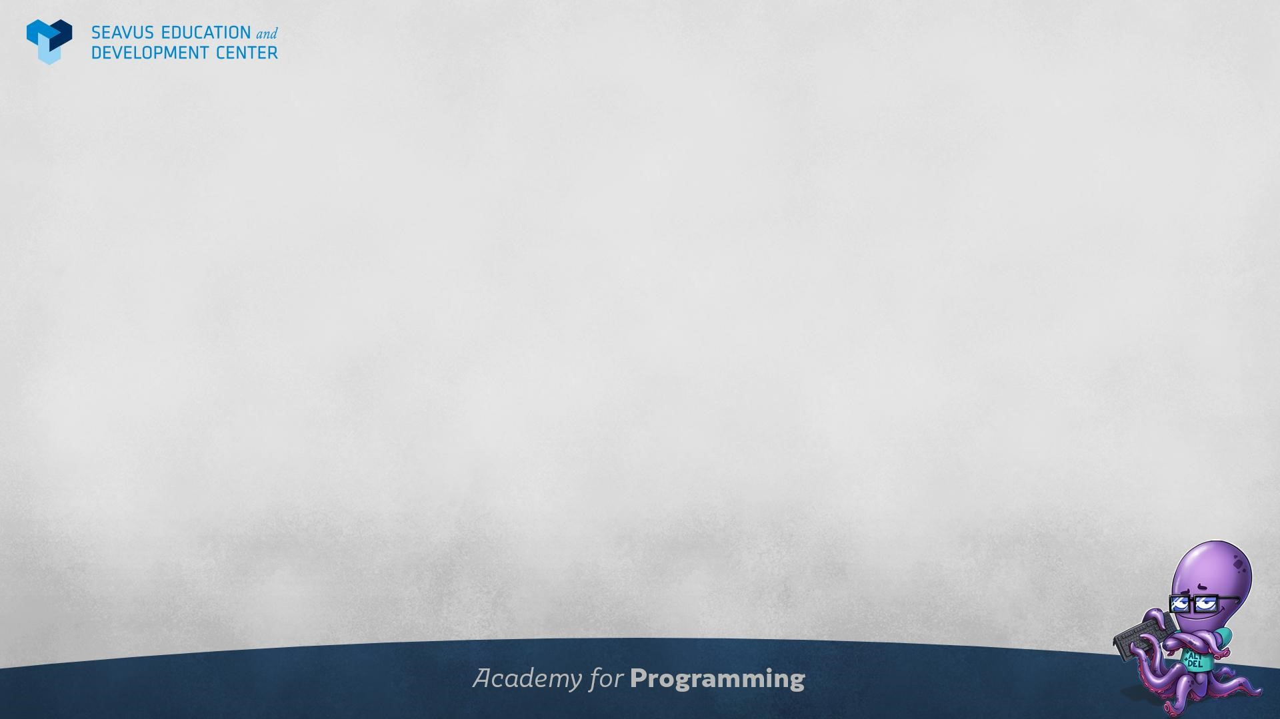
Agenda
Session 7
Quiz
Homework discussion
Errors and messages
Basic database administration
Backups
Database roles

Slide 3
Quiz

Slide 4
Homework discussion

Slide 5
Errors and messages

Slide 6
Reporting messages and errors 1/2
To raise a message, you use the raise statement as follows:
raise level format;
Following the raise statement is the level option that specifies the error severity.
PostgreSQL provides the following levels:
debug
log
notice
info
warning
exception
If you don’t specify the level, by default, the raise statement will use exception level that raises an error and stops the current transaction.

Slide 7
Reporting messages and errors 2/2
The format is a string that specifies the message. The format uses percentage (%) placeholders that will be substituted by the arguments.
The number of placeholders must be the same as the number of arguments, otherwise, PostgreSQL will issue an error.
To raise an error, you use the exception level after the raise statement. Note that raise statement uses the exception level by default.

Slide 8
Basic database administration

Slide 9
Backup and restore
PostgreSQL databases should be backed up regularly.
The SQL dump method is to generate a text file with SQL commands that, when fed back to the server, will recreate the database in the same state as it was at the time of the dump. PostgreSQL provides the utility program pg_dump for this purpose.
The text files created by pg_dump are intended to be read in by pgAdmin.
To restore the backed up database, you can choose any existing database and run the generated file.

Slide 10
Workshop
Backup and restore a database.

Slide 11
Database roles
PostgreSQL manages database access permissions using the concept of roles.
A role can be thought of as either a database user, or a group of database users, depending on how the role is set up.
Roles can own database objects (for example, tables and functions) and can assign privileges on those objects to other roles to control who has access to which objects.
The concept of roles includes the concepts of "users" and "groups". Any role can act as a user, a group, or both.

Slide 12
Database roles
Database roles are conceptually separate from operating system users.
Database roles are global across a database cluster installation (and not per individual database).
To create a role, use the CREATE ROLE SQL command:
CREATE ROLE name;
To determine the set of existing roles, select from the pg_roles system catalog:
SELECT rolename FROM pg_roles;

Slide 13
Role attributes 1/2
A database role can have several attributes that define its privileges and interact with the client authentication system.
login privilege
Only roles that have the LOGIN attribute can be used as the initial role name for a database connection. A role with the LOGIN attribute can be considered the same as a "database user".
CREATE ROLE name LOGIN;
CREATE USER name;
superuser status
A database superuser bypasses all permission checks, except the right to log in.
CREATE ROLE name SUPERUSER
database creation
A role must be explicitly given permission to create databases.
CREATE ROLE name CREATEDB

Slide 14
Role attributes 2/2
role creation
A role must be explicitly given permission to create more roles.
CREATE ROLE name CREATEROLE
initiating replication
CREATE ROLE name REPLICATION LOGIN
password
A password is only significant if the client authentication method requires the user to supply a password when connecting to the database.
CREATE ROLE name PASSWORD ‘string’

Slide 15
Workshop
Create a new role called ‘login_only’ both through pgAdmin user interface and through SQL query. It should only have login privilege.
Create a new role called ‘superuser’ both through pgAdmin user interface and through SQL query. Assign it all privileges.

Slide 16
Workshop
How can you output a list of all members, including the individual who recommended them (if any), without using any joins? Ensure that there are no duplicates in the list, and that each firstname + surname pairing is formatted as a column and ordered.

Slide 17
Questions and discussion

